Slide 1
Movie review generation
Ole Jonas and Martin
Fine-tuning a GPT-2 model on IMDB reviews

Slide 2
Introduction
The motivation behind this project

Slide 3
01
Agenda
Introduction
02
The creation of training prompts
03
Experimental setup
04
Evaluation and discussion
05
Conclusion and future work

Slide 4
The creation of training prompts
Dataset by Maas et al. (2011)
Dataset on Kaggle
Text preprocessing
Prompt format

Slide 5
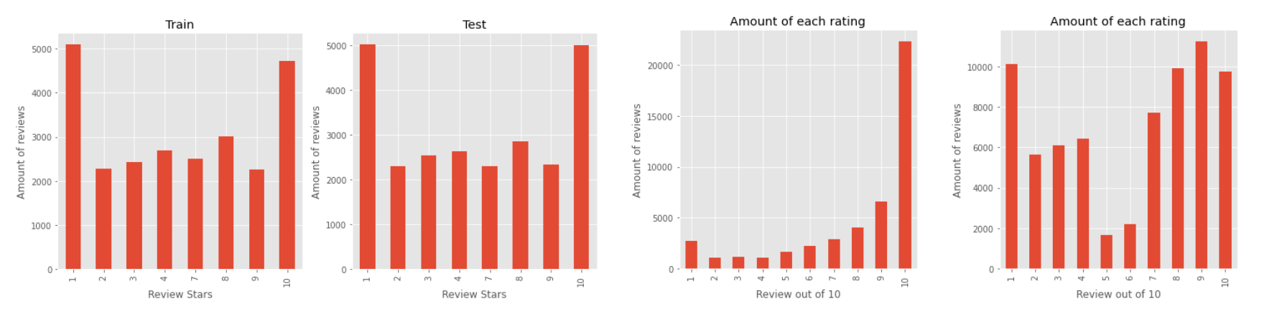
The creation of training prompts
Rating | Review
2 | Story of a man who has unnatural feelings for ...
4 | Airport '77 starts as a brand new luxury 747 p...
10 | Although I'm not a golf fan, I decided to watch...
Dataset by Maas et al. (2011)
Dataset on Kaggle
Text preprocessing
Prompt format

Slide 6
The creation of training prompts
Rating | Review
2 | Story of a man who has unnatural feelings for ...
4 | Airport '77 starts as a brand new luxury 747 p...
10 | Although I'm not a golf fan, I decided to watch...
+
Dataset by Maas et al. (2011)
Dataset on Kaggle
Text preprocessing
Prompt format
Rating | Review
5 | This film lacked something I couldn't put my f...
6 | This movie, with all its complexity and subtle...
9 | I've seen this story before but my kids haven'...

Slide 7
The creation of training prompts
Rating | Review
2 | Story of a man who has unnatural feelings for ...
4 | Airport '77 starts as a brand new luxury 747 p...
10 | Although I'm not a golf fan, I decided to watch...
5 | This film lacked something I couldn't put my f...
6 | This movie, with all its complexity and subtle...
Rating | Review
2 | Story of a man who has unnatural feelings for ...
4 | Airport '77 starts as a brand new luxury 747 p...
10 | Although I'm not a golf fan, I decided to watch this movie anyway. And I am very pleased I did!!! This movie is a masterpiece ✨ <br> For everyone wondering whether it is worth the trip to the cinema, I will certainly say so [!]
6 | This movie, with all its complexity and subtle...
9 | I've seen this story before but my kids haven'...
Dataset by Maas et al. (2011)
Dataset on Kaggle
Text preprocessing
Prompt format

Slide 8
The creation of training prompts
Rating | Review
2 | Story of a man who has unnatural feelings for ...
4 | Airport '77 starts as a brand new luxury 747 p...
10 | Although I'm not a golf fan, I decided to watch this movie anyway. And I am very pleased I did!!! This movie is a masterpiece ✨ <br> For everyone wondering whether it is worth the trip to the cinema, I will certainly say so!?!?
6 | This movie, with all its complexity and subtle...
9 | I've seen this story before but my kids haven'...
10 | Although I'm not a golf fan, I decided to watch this movie anyway. And I am very pleased I did! This movie is a masterpiece For everyone wondering whether it is worth the trip to the cinema, I will certainly say so !
10 | Although I'm not a golf fan, I decided to watch this movie anyway. And I am very pleased I did! This movie is a masterpiece <br> For everyone wondering whether it is worth the trip to the cinema, I will certainly say so [!]
10 | Although I'm not a golf fan, I decided to watch this movie anyway. And I am very pleased I did! This movie is a masterpiece For everyone wondering whether it is worth the trip to the cinema, I will certainly say so [!]
10 | Although I'm not a golf fan, I decided to watch this movie anyway. And I am very pleased I did! This movie is a masterpiece ✨ <br> For everyone wondering whether it is worth the trip to the cinema, I will certainly say so [!]
10 | Although I'm not a golf fan, I decided to watch this movie anyway. And I am very pleased I did!!! This movie is a masterpiece ✨ <br> For everyone wondering whether it is worth the trip to the cinema, I will certainly say so [!]
Dataset by Maas et al. (2011)
Dataset on Kaggle
Text preprocessing
Prompt format

Slide 9
The creation of training prompts
10 | Although I'm not a golf fan, I decided to watch this movie anyway. And I am very pleased I did! This movie is a masterpiece For everyone wondering whether it is worth the trip to the cinema, I will certainly say so !
Dataset by Maas et al. (2011)
Dataset on Kaggle
Text preprocessing
Prompt format
10<|rating|>Although I'm not a golf fan, I decided to watch ...

Slide 10
Experimental setup
Temperature
The model’s craziness / randomness
Top k sampling
Sampling from top k most probable words
Nucleus sampling
Sampling from top p most probable distributions

Slide 11
Discussion
Part 1 – Hyperparameter impact

Slide 12
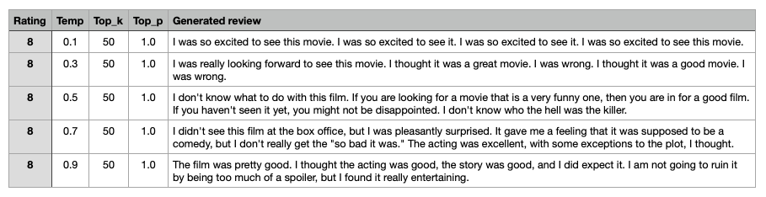
Temperature

Slide 13
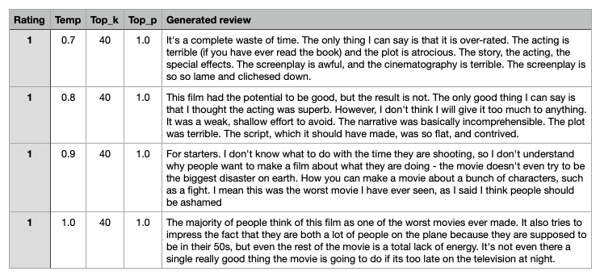
Temperature

Slide 14
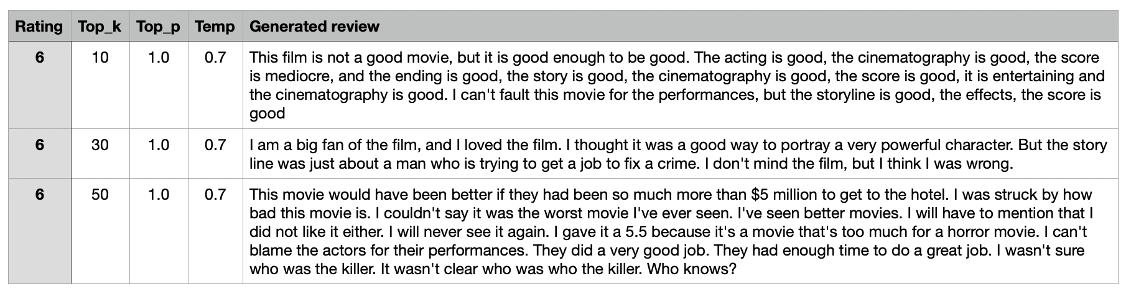
Top k sampling

Slide 15
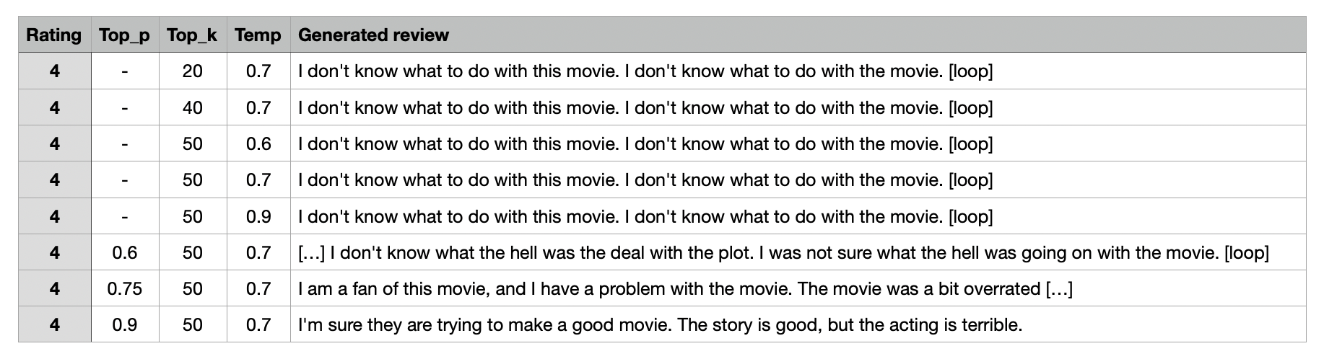
Nucleus sampling

Slide 16
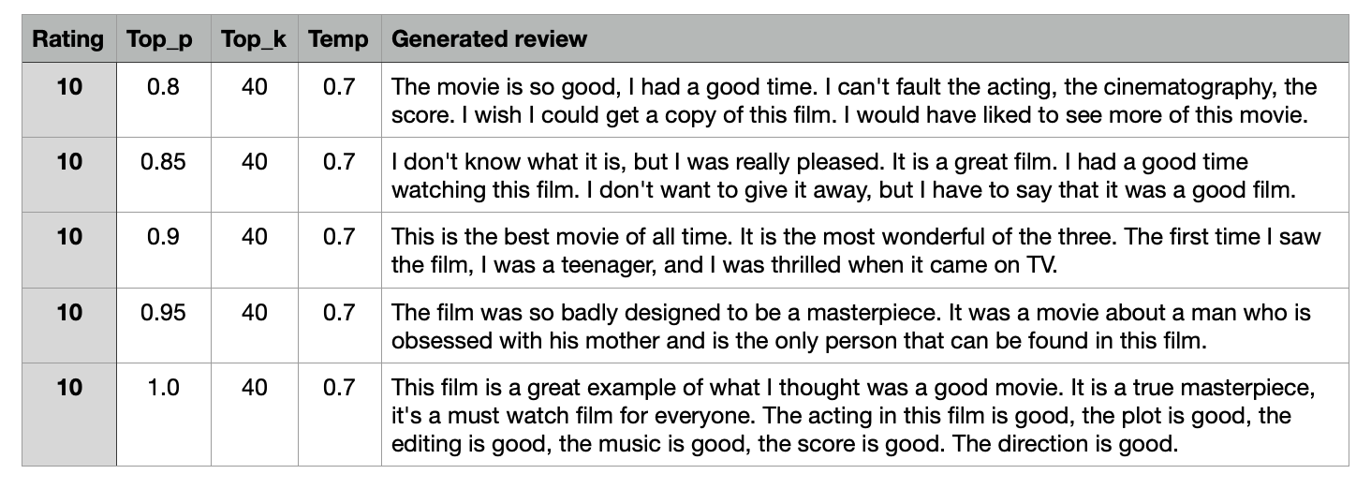
Nucleus sampling

Slide 17
Discussion
Part 2 – Does the review match the prompted rating?

Slide 18
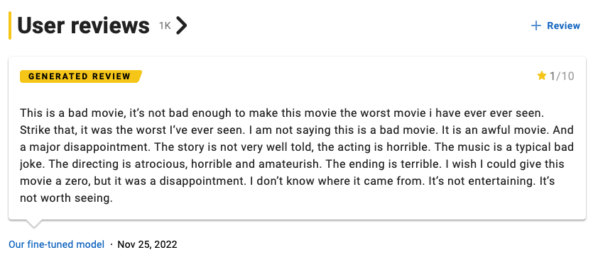
Generated review #1

Slide 19
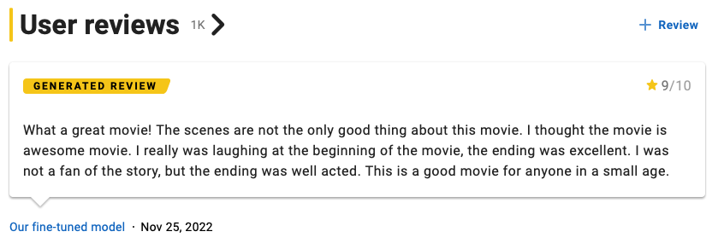
Generated review #2

Slide 20




Conclusion
Is it possible to make good reviews with a prompted rating?
+
= ?
https://www.imdb.com/pressroom/brand-guidelines/

Slide 21
Future work
Where is it most room for improvement?

Slide 22
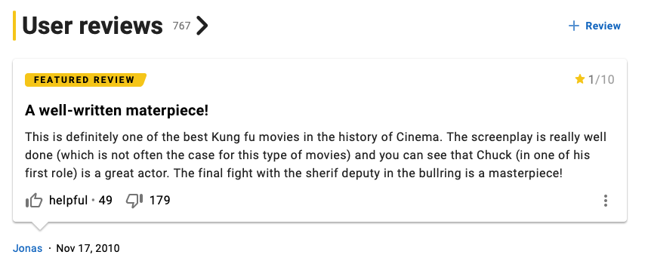
—Guess the rating
?

Slide 24
Metric
How do we evaluate the model?
BLEU score (not suited)
Grammatical score could be appropriate
Automatic classification of rating

Slide 25
Thank you
For your attention

Slide 26
🔥
Any questions?

